Slide 1
World Electricity Analysis
Group – 6
Vaishali Sharma
Tejas Natani
Tejas Ingle
Amit Singh

Slide 2



OBJECTIVE AND Overview
Dataset Overview
World Electricity Access of all countries since 1960
Electricity Production across the world by different sources (nuclear , oil , renewable)
Overall transmission loss across the world
Objective
Analysis of access to the electricity based on different parameter as a function of time
Getting meaningful insights of Electricity Production by different Sources (nuclear , oil , renewable)
Transmission loss across the world and getting trends & insights

Slide 3
Region wise access to electricity
There is high proportion of electrification in developed regions ( North America & Europe )
There is no difference in access to electricity between urban and rural areas of those economically developed regions
In Developing economies there is stark difference between the distribution of electricity between the rural and urban areas.
Rural areas of developing countries have considerably less access to electricity as compared to their urban counterparts.

Slide 4
Decade wise growth of electrification (region)
Economically developed regions had already achieved complete electrification by 90s
In 1990s Developing regions had comparatively less access to electricity owing to belonging to lower income group as compared to the developed economies.
In last three decades developing economies have shown a great increment in overall access to electricity specially after 2000 as they develop gradually.

Slide 5
count of countries (75%+ access)
There has been gradual increase in countries having minimum 75% of electrification. Most of growth in count of these countries comes from countries belonging to lower economic group.
2000s have seen a sharp increase in total count of countries having minimum 75% electricity access as such countries are gradually developing.
Developing countries have contributed most in increasing Trend.

Slide 6
Energy production comparison
As we know Oil is non-renewable source of energy and cheaper source to produce electricity and easier to acquire
Producing electricity using oil or non - renewable sources produces lots of hazardous waste and pollutes the environment.
As we can see , reliance on nuclear energy is more in North-America and Europe whereas rest regions relies more on oil sources.

Slide 7
Nuclear vs oil production (INCOME-wise)
Nuclear sources are quite hard to acquire and much expensive to generate electricity. But it the one of the cleaner and efficient source of generating electricity.
As we can see , high income and upper middle income countries relies more on nuclear sources as compared oil.
Oil being overall easy to acquire and comparatively cheaper to generate electricity.
As seen in chart , low income and lower middle income countries prefer oil sources as compared to nuclear as they also face technological hurdles to produce nuclear energy.

Slide 8
renewable electricity production
As seen in previous charts, nuclear production is more efficient and clean. Renewable energy provides similar benefits at comparatively cheaper cost.
Though the efficiency remains low compared to non renewable sources , overall efficiency is greater in the long run.
There is similar pattern found in the usage of nuclear sources and renewable sources. i.e developed regions are increasing production using renewable sources whereas developing region are unable to invest in the infrastructure.
Some of developing regions have great potential towards renewable energy in the future.

Slide 9
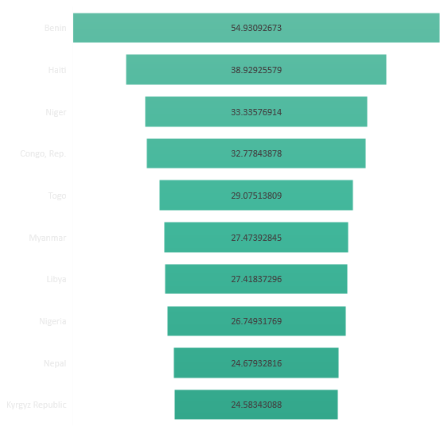
Transmission loss (top 10 countries)
On research , its found that most countries having higher proportion of transmission loss belongs to poor economy.
Which on further inspection, proved that one of the main reason could be faulty infrastructure among many others.
Due to poor economies, there could be funds issues which result into outdated infrastructure.
Many countries are going through or went through issues such as political conflicts , civil war etc. which exacerbated to the above given issues.

Slide 10
Top 10 countries (highest % growth in 2 decades)
On analyzing it is found that many of the countries having highest growth in electrification have a great tourism attraction which contributes to the need of better infrastructure for electricity.
Also one of the major contributing factor for the need of electrification is emerging economies. Improving economies constitutes to the need of great infrastructure, facilities which further necessitates the growing demand of electricity.
Geographic and demographic factors of location constitutes to cater growing need of electricity due to multiple factors such as harsh climate , tourism and growing population.

Slide 11
Conclusions
North America And Europe have the highest average electrification in both rural and urban areas as they are among highly developed regions in the world.
Regions belonging to lower and lower middle income have comparatively lower electrification along with considerable difference of distribution between rural and urban areas.
There is gradual increase in number of developing countries accomplishing minimum 75% electrification over the last two decades.
Developed regions have increased their electricity production through nuclear sources whereas some developing regions have gradually started increasing their foothold in nuclear power generation while some regions have been unable to do so.
Higher income region have been in forefront of increasing renewable energy production along with nuclear sources whereas middle and lower middle countries are in gradual process.
Transmission loss has been highest among the countries having poor economy, political instability , infrastructure issues and outdated technologies.
Countries having emphasis on tourism , geographical & demographic constraint have seen highest growth rate of electrification in the last two decades.

Slide 12
Challenges and Learning
Python challenges
SQL challenges
Team learning

Slide 13
THANK YOU !!!

